Slide 1
KAKINADA INSTITUTE OF ENGINEERING &TECHNOLOGY 2022-2024
SECURE CLOUD STORAGE WITH DATA DYNAMICS USING SECURE NETWORK CODING TECHNIQUES
Under the guidance of Presented by
MR.K.RAJESH, MCA, M.Tech(P.hD) Name : SYAMALA
Assoc. Professor & HOD Reg No : 22B21F0073
Master of Computer Applications.

Slide 2
Secure Cloud Storage with Data Dynamics Using Secure Network Coding Techniques

Slide 3
CONTENTS:
ABSTRACT
EXISTING SYSTEM AND DIS-ADVANTAGES
PROPOSED SYSTEM AND ADVANTAGES
MODULES
SYSTEM ARCHITECTURE
SOFTWARE REQUIREMENTS
HARDWARE REQUIREMENTS
UML DIAGRAMS
SCREENSHOTS
CONCLUSION

Slide 4
ABSTRACT:
Secure cloud storage protocols enable a client to check integrity of outsourced data.
The possibility of constructing a secure cloud storage for dynamic data by leveraging the algorithms involved in secure network coding.
We show that some of the secure network coding schemes can be used to construct efficient secure cloud storage protocols for dynamic data.

Slide 5
EXISTING SYSTEM:
A client having a smart phone with a low-performance processor or limited storage cannot accomplish heavy computation or store large volume of data.
Under such circumstances, it can delegate the computation/storage to the cloud server. In that existing the harmonic algorithm is implemented. In that we find there is no security for the particular file in the cloud.

Slide 6
DISADVANTAGES OF EXISTING SYSTEM:
The data leakage problem is detected.
There is no authorization for uploading the data.

Slide 7
PROPOSED SYSTEM:
It proposes a hybrid cloud consisting of private and public cloud that can improve the security systems.
Secure cloud storage protocol for dynamic data constructed using secure network coding techniques which is secure in the standard model.
Although generic dynamic data support arbitrary insertions, deletions and modifications, append-only data find numerous applications in the real world.

Slide 8
ADVANTAGES OF PROPOSED SYSTEM:
The system is more effective due to presence of Provable Data Possession (PDP) techniques.
The system is more accurate due to presence of Authenticated Data Structures Used in DSCS.
High security.

Slide 9
Modules
Data owner
Cloud Server
Third Party Auditor
End User

Slide 10
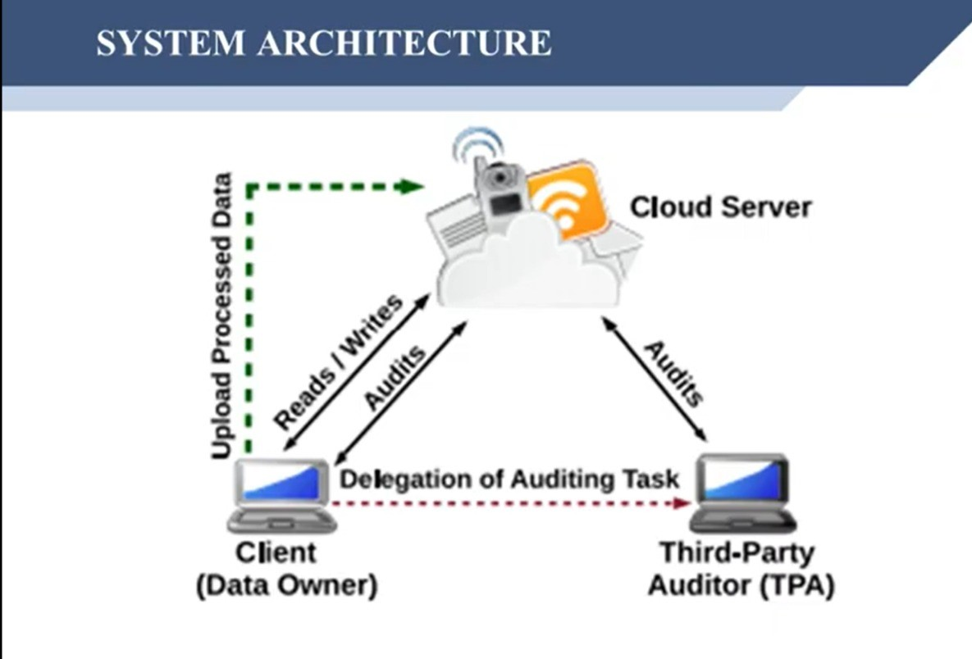
SYSTEM ARCHITECTURE

Slide 11
SOFTWARE REQUIREMENTS:
Operating system : Windows 7.
Front End : HTML, Java, Jsp
Scripts : Java Script
Database : MYSQL
Database Connectivity: JDBC

Slide 12
HARDWARE REQUIREMENTS:
System : Core I3.
Hard Disk : 500 GB.
Ram : 2 GB.

Slide 13
UML Diagrams
Use Case Diagram
Sequence Diagram
Collaboration Diagram
Class Diagram
Activity Diagram

Slide 14
Use Case Diagram

Slide 15
Sequence Diagram

Slide 16
Class Diagram

Slide 17
Activity Diagram

Slide 18
SCREEN SHOTS

Slide 19
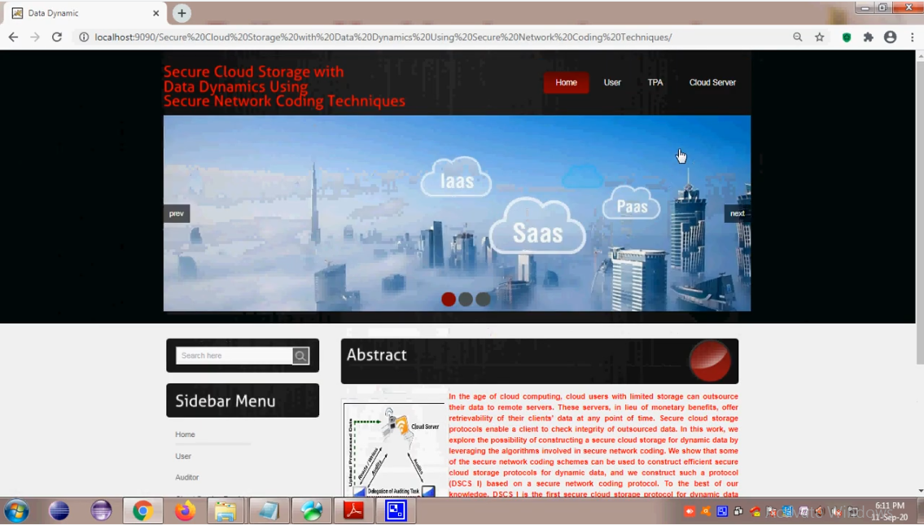
Home Page

Slide 20
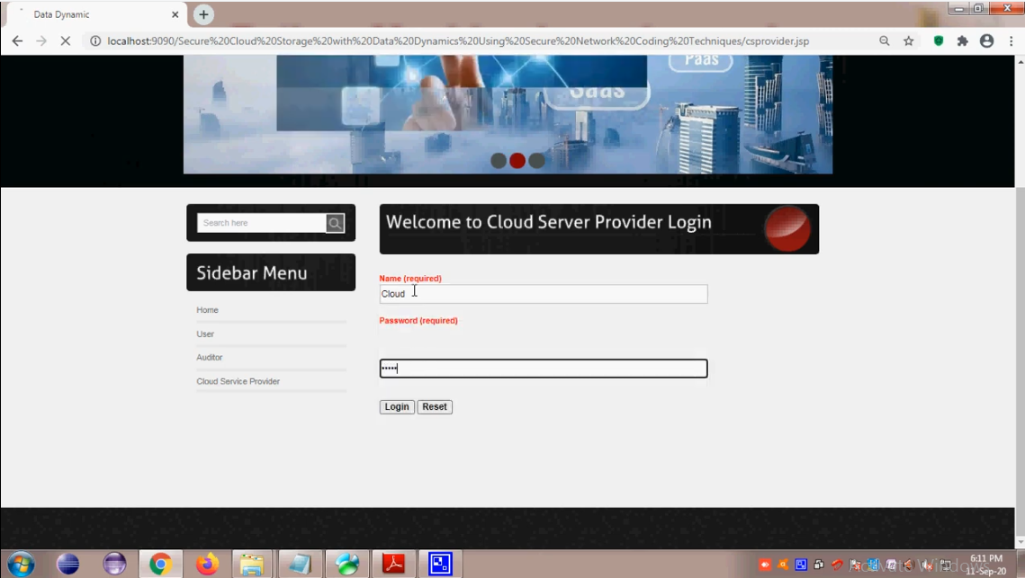
CLOUD SERVER LOGIN PAGE

Slide 21
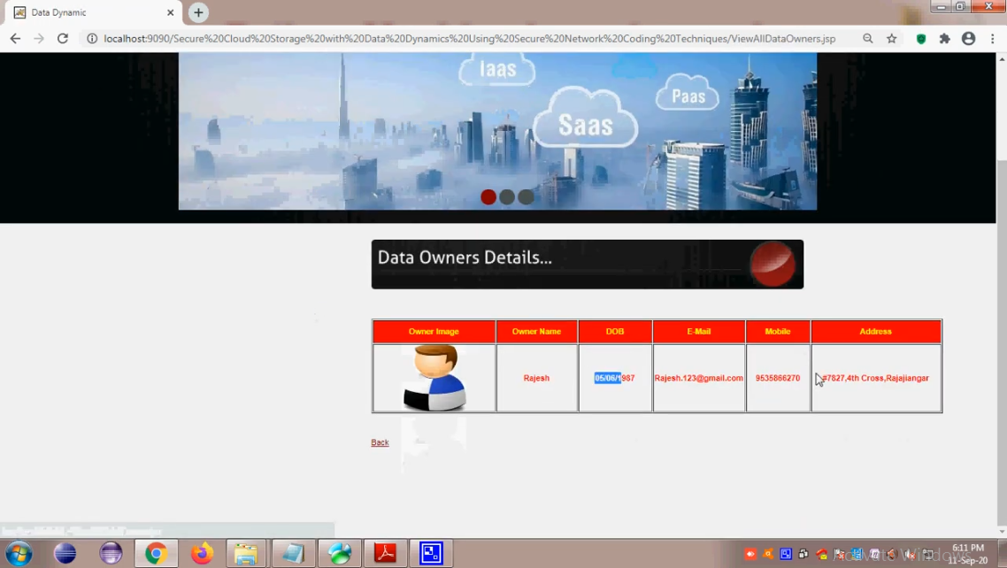
VIEW DATA OWNERS DETAILS PAGE

Slide 22
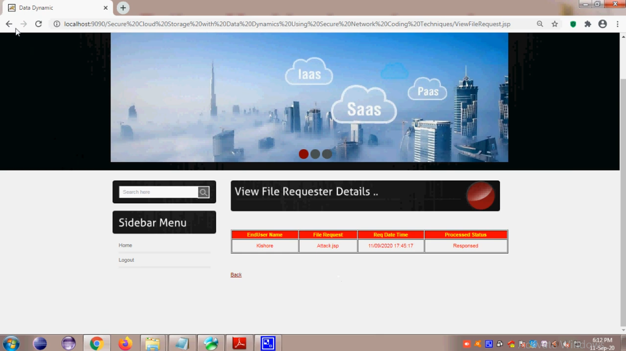
VIEW FILE REQUESTER DETAILS

Slide 23
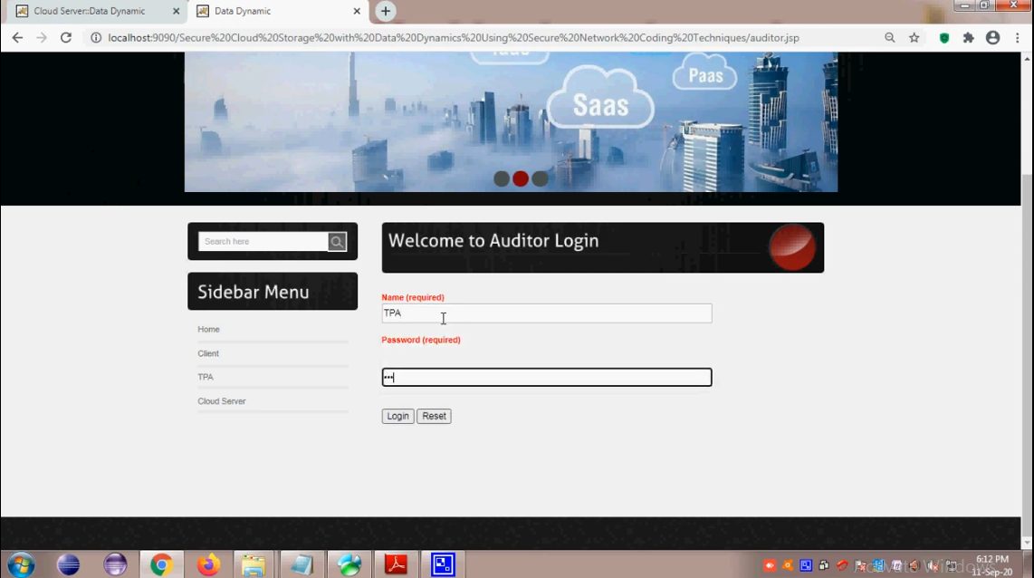
TPA LOGIN PAGE

Slide 24
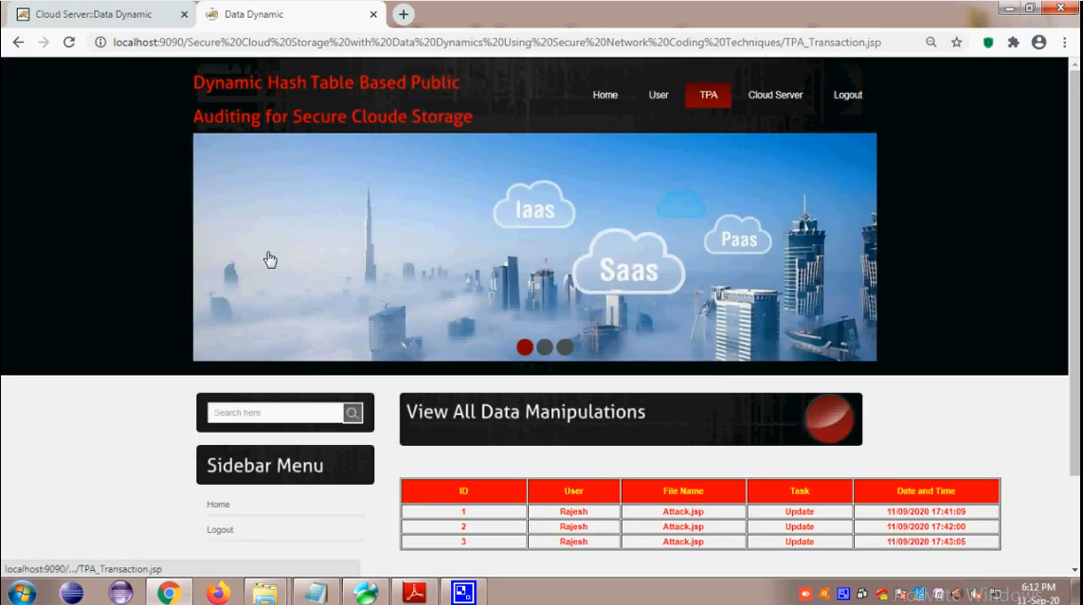
VIEW ALL DATA MANIPULATIONS

Slide 25
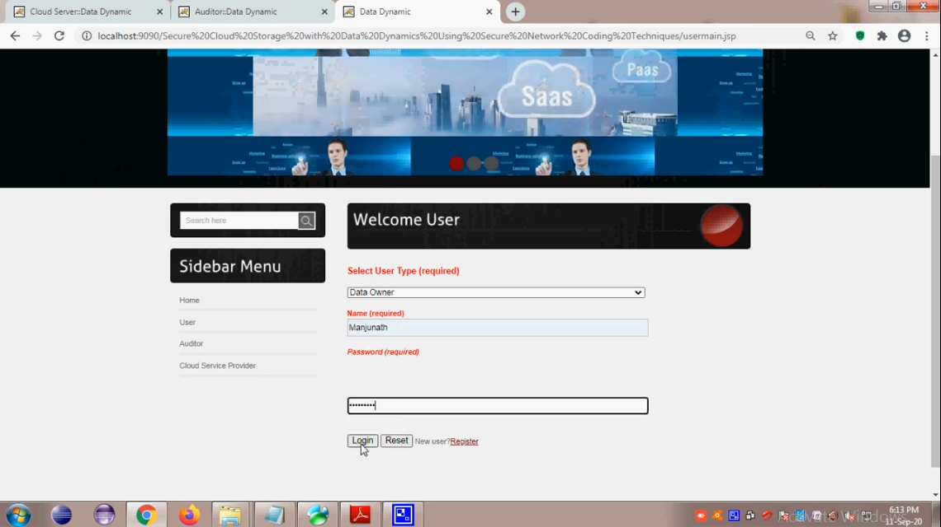
USER LOGIN PAGE

Slide 26
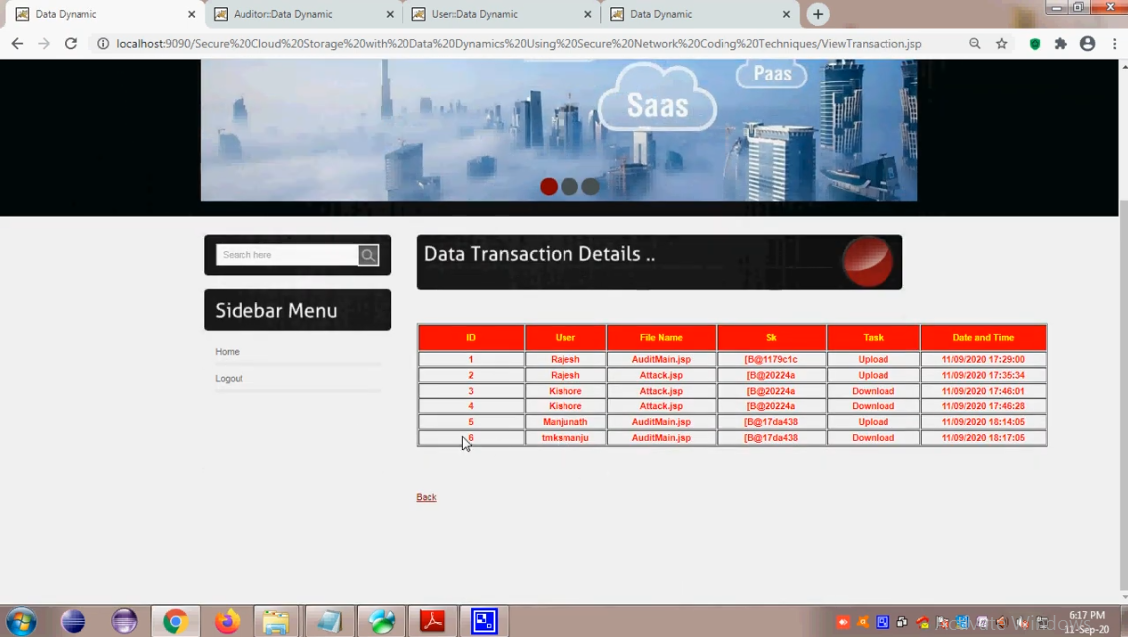
DATA TRANSACTION DETAILS

Slide 27
Conclusion
We have discussed some challenges while constructing an efficient DSCS protocol from an SNC protocol. We have also identified some limitations of an SNC- based secure cloud storage protocol for dynamic data.
A more efficient SNC protocol can give us a DSCS protocol with better efficiency. We have also identified certain SNC protocols suitable for append-only data and constructed an efficient DSCS protocol (DSCS II) for append only data.

Slide 28
Thank You

